Slide 1
Upcycle Your Book!
An Earth Day Program

Slide 2
What is upcycling?
Pickerington Public Library DIY Pinterest Board

Slide 3
Our Craft: book folding
Supplies:
Book
Ruler with centimeters
Writing Utensil
Instructions pulled from Instructables.com

Slide 4
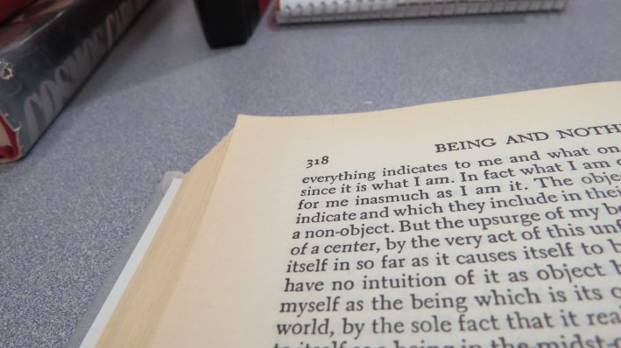
Step one: find the middle of your book
How many pages are in your book?
Split that number in half.
Open your book to the halfway point.
Count 20 pages back from the halfway point. This is where you will start.

Slide 5
Step two: position the book
Hold the book like you would if you were reading it.
Turn the book a quarter turn, so that the page numbers are on the upper left.

Slide 6
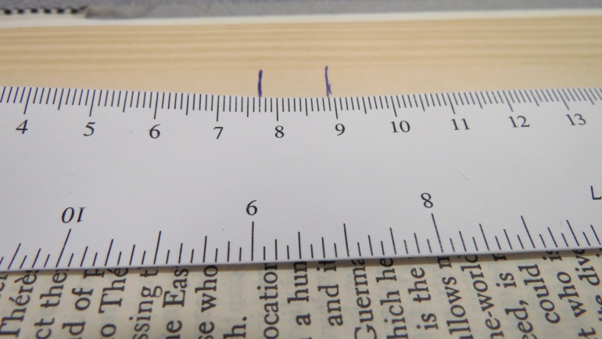
Step three: mark the pages
On the first page, measuring from left to right, mark the page at 7.7 cm and 8.9 cm.
The gap between your marks should be 1.2 cm.

Slide 7
Step three continued
Flip to the next page. You will always be measuring the page on top.
Mark the second page at 7.1 cm and 9.6 cm.
Use the handout to get the rest of the values for the remaining 28 pages.

Slide 8
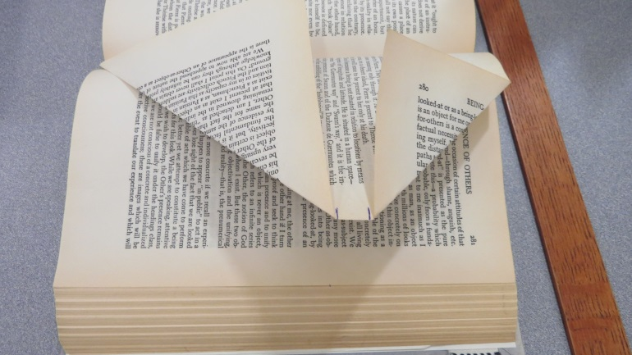
Step four: folding
Flip the book so that the marked pages are now on the bottom.
Fold each page 90 degrees at each mark you have made. See picture.

